Slide 1





Sentiment Beyond Text: A Multimodal Framework for
Movie Review Classification

Slide 2

Supervised By,
Md. Reasad Zaman Chowdhury Lecturer, Department of CSE, AUST
Presented By
Group 4723
Sanjana Akhter 20210104150
Md. Mostafizur Rahman 20210104151
Mahajabin Haque 20210104154

Slide 3




contents
1
5
Result Analysis
Introduction
Project Management
2
Literature Review
6
3
Dataset
Ethics and Complex Engineering
4
Methodology
Conclusion & Future
work
8

Slide 4

Introduction
Problem Statement
Motivation
Objective

Slide 5

Problem Statement
Linguistic Complexity
Binary Limitations
Class imbalance
Data Heterogeneity

Slide 6
MOTIVATION
Movie reviews influence public opinion and Box office
Real-world reviews include sarcasm, imbalance, and mixed formats.
Capturing Neutral Sentiment Reality
A flexible system is needed to extract reliable sentiment insights.

Slide 7
OBJECTIVE
Curate Multimodal Data & Derive "Neutral" Class
Identify Key Features via Ensemble Ranking
Preprocess and standardize review text, genre, and rating features.
Benchmark ML Baselines vs. Transformers
Optimize Hyperparameters & Evaluate Metrics

Slide 8

LITERATURE REVIEW
Literature Review
Research Gap

Slide 9

Literature Review
Title
Work
Utilizing Machine Learning for Sentiment Analysis of IMDb Movie Review Data [2023]
Applied machine learning models to sentiment classification using feature extraction with Bag of Words and TF-IDF. Logistic Regression with TF-IDF achieved the best results: 89.20% accuracy, 88.80% precision, and 89.80% recall.
Author
Ubaid Mohamed Dahir, Faisal Kevin Alkindy
Dataset Used:
Model
IMDb Movie Reviews (10,000 Data)
Logistic Regression, SVM, Random Forest

Slide 10
Literature Review
Title
Work
Comparative analysis of rotten tomatoes movie reviews
using sentiment analysis [2022]
Benchmarked statistical classifiers against deep learning. Found that optimized SVM achieved the highest accuracy (77.5%), significantly outperforming the deep learning baseline (58.6%).
Author
Soni et al.
Dataset Used:
Model
Rotten Tomatoes
MNB, SVM , Deep Learning Baseline

Slide 11
Literature Review
Title
Work
Understanding viewer opinions: Sentiment analysis on
movie review using vader and lstm model [2024]
Compares lexicon-based (VADER) and deep learning (LSTM) approaches for sentiment analysis. LSTM achieved 87.12% accuracy and an F1-score of 0.90, outperforming VADER’s 70.00% accuracy and 0.74 F1-score.
Author
A. D. Azahree and N. Alias
Dataset Used:
Model
IMDb 50,000 Movie Reviews
VADER, LSTM (with GloVe embeddings)

Slide 12

Literature Review
Title
Work
Sentiment analysis of imdb movie reviews based on lstm [2025]
Applied Word2Vec embeddings with an LSTM classifier to handle large-scale text data. The model achieved 92.65% accuracy, demonstrating strong generalization capabilities.
Author
Lu et al.
Dataset Used:
Model
LSTM (with Word2Vec embeddings)

Slide 13
Literature Review
Title
Work
Bert + bilstm: Boosting performance in movie review sentiment classification [2025]
Explored a three-class sentiment problem. The hybrid model achieved only ≈65% accuracy, highlighting the difficulty of classifying non-binary sentiment compared to binary tasks
Author
Rongjun Gao
Dataset Used:
Model
Kaggle IMDb Dataset (~35,000 reviews)
Hybrid BERT + BiLSTM

Slide 14
Literature Review
Title
Work
Sentiment Analysis of Movie Review Classifications Using Deep Learning Approaches [2024]
Evaluates deep learning models for sentiment analysis. XLNet achieved the best performance with 87.68% accuracy and an F1-score of 85.95%, followed by BERT. Transformer models outperformed CNN-LSTM and LSTM, highlighting their strength in capturing complex sentiment patterns.
Author
Sarwar Shah Khan, Yasser Alharbi
Dataset Used:
Model
Rotten Tomatoes (50,000 Data, 1 Feature(Review Text))
XLNet, BERT, CNN-LSTM, LSTM

Slide 15


RESEARCH GAP
1
Limited Dataset Scope
2
Reliance on Text-Only Analysis
3
Oversimplified binary classification
4
Ambiguity in Defining "Neutral"

Slide 16
Dataset
Dataset info, preview and selection
Preprocessing and 3 class target generation
Sentiment label distribution
Feature selection

Slide 17





Dataset INFO
Collected from Kaggle
Rotten Tomatoes Dataset (Reviews + Metadata)
Almost 195,000 entries, 8 Features
Focused on both review content and movie metadata

Slide 18


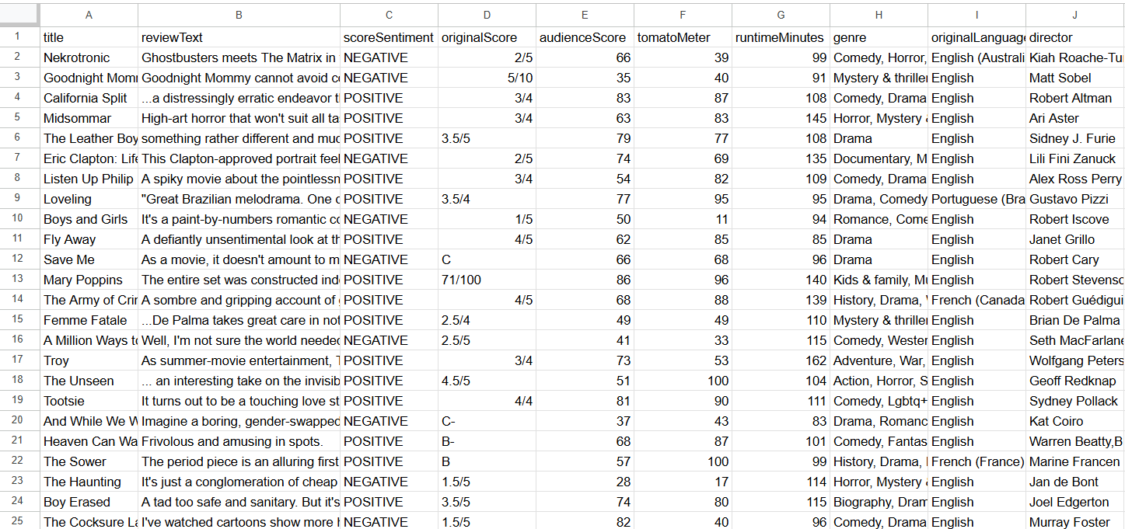
Dataset Preview

Slide 19

Data selection
Merged two datasets using id as key
Selected key fields: reviewText, genre, runtime, scores, etc.
Removed rows with missing values
Filtered non English reviews
Limited reviews per movie to prevent blockbuster bias

Slide 20



PREPROCESSING
Audience Score Normalization
Text cleaning
Score Scaling
Genre Standardization
Language and Director Encoding
Additional missing rows removed

Slide 21


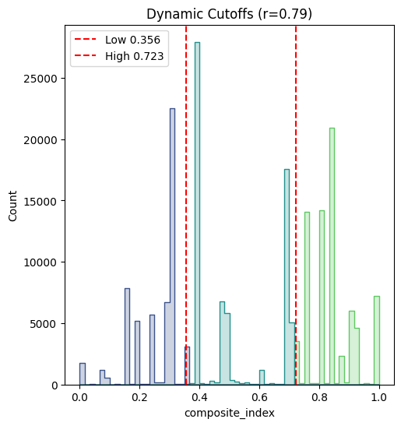
3-Class Target Generation
Mathematically derived a "Neutral" class
Point - Biserial Correlation between user scores and binary labels
Weighted index for combining both
Dynamic Thresholding using anchors and Linear interpolation
Fig : 3 class dynamic thresholding

Slide 22

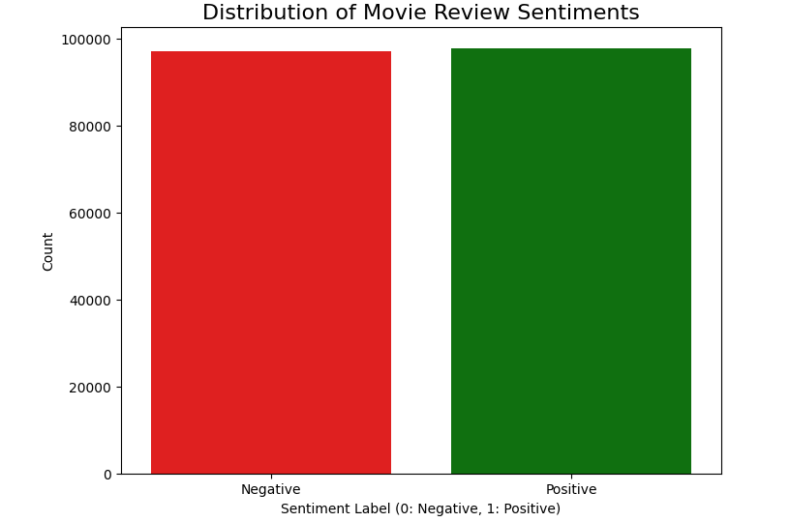
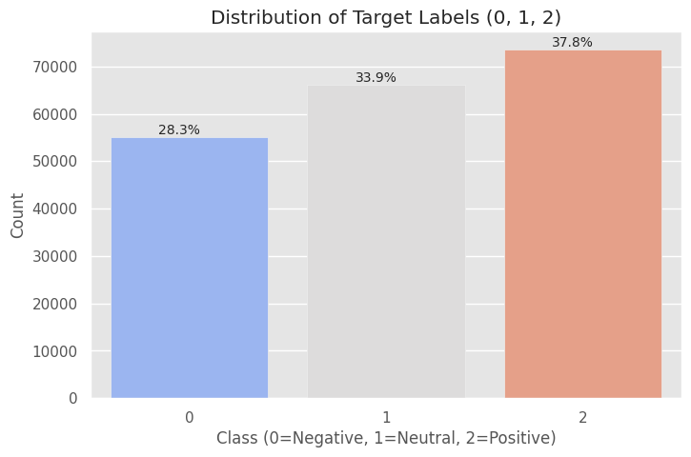
Sentiment LABEL DISTRIBUTION
Fig : Target distribution for Binary (Equal)
Fig : Target distribution for 3-class

Slide 23

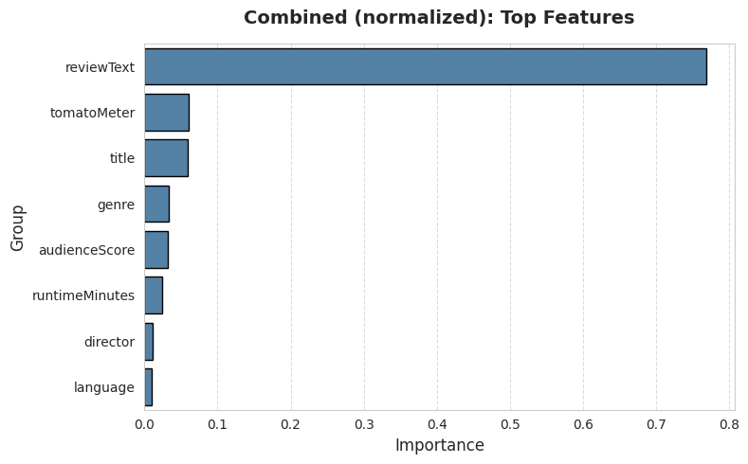
Feature Selection
Importance Ranking using Ensemble
Top-ranked features: reviewText , genre, tomatoMeter, title
Lower-ranked features: language, director
Created three test sets (All Features, Top 4, Text-Only) to benchmark model performance
Fig : Top Features

Slide 24

Methodology
Methodology Overview
Dual Stream Framework
Experimental design and Metrics
Implementation and Training

Slide 25
Methodology Overview
Dual Stream Framework : Statistical ML and Transformers
TF-IDF and traditional ML baselines
Transformer-based Deep Learning with latent feature fusion.
Validation: Stratified 80/20 train-test split.

Slide 26

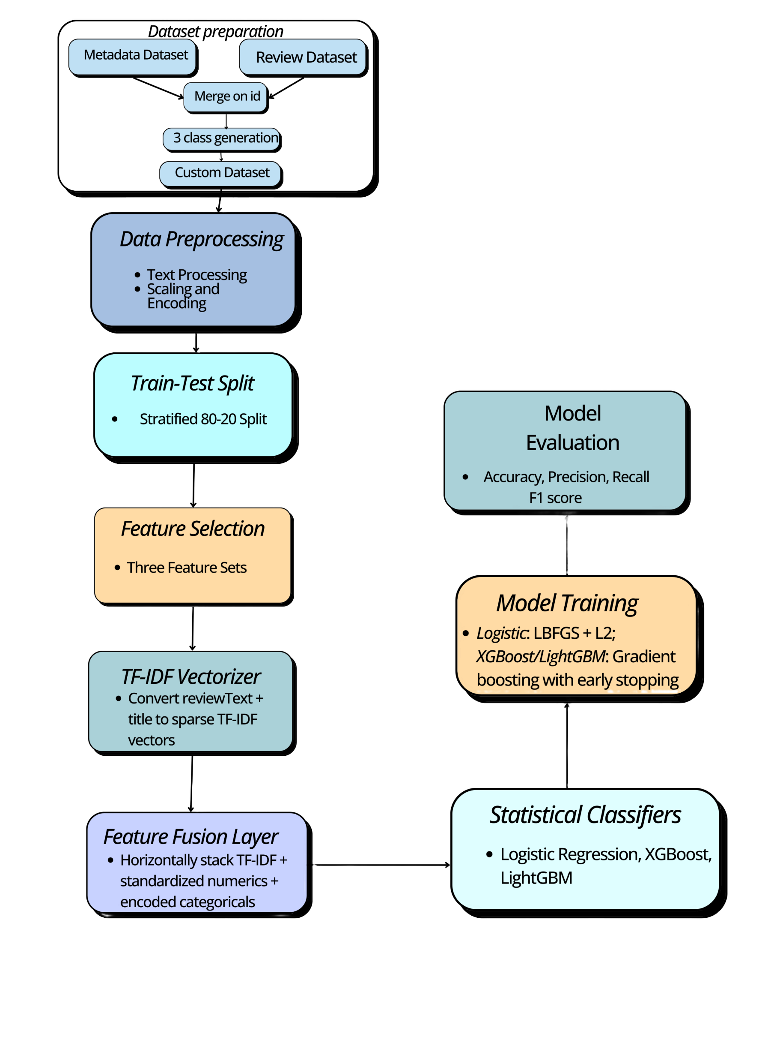
Statistical Machine Learning
Text representation : Text to sparse TF-IDF vectors
Feature Fusion : Horizontally stacks TF-IDF vectors with standardized metadata
Classifiers : Deployed Logistic Regression, XGBoost , and LightGBM
Optimization : Used class_weight='balanced' to handle class imbalance
Fig : ML model pipeline

Slide 27
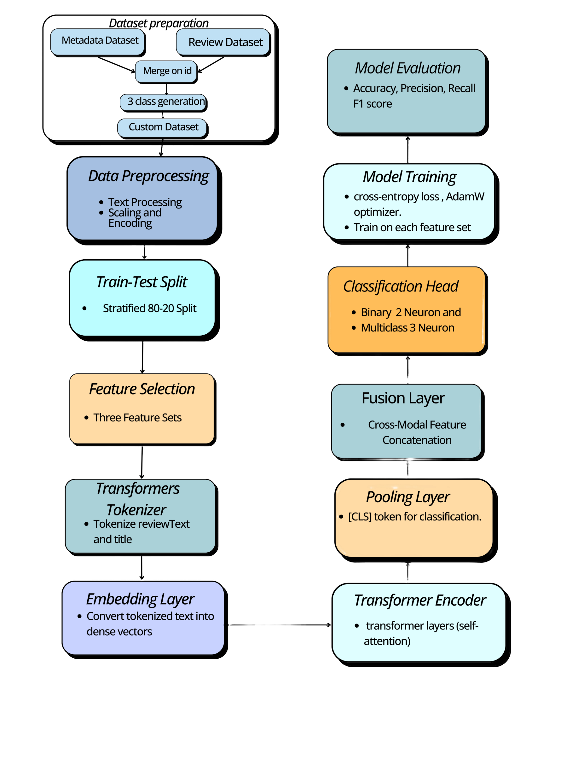
Transformer Late Fusion
Semantic Encoding : Pre-trained backbones to extract [CLS] token embeddings.
Late Fusion Architecture : Learns text semantics independently before integrating with structured metadata.
Fusion Mechanism : Concatenates the semantic vector with the metadata vector.
Classification Head : Passes fused data through a Dropout layer and a final Linear layer.
Fig : Transformer model pipeline

Slide 28

Experimental Design & Metrics
Environment 1 (Text-Only): Establishes a linguistic baseline using only reviewText.
Environment 2 (Top-4 Metadata): Integrates text with top-ranked features (tomatoMeter, title, genre).
Environment 3 (All Features): Utilizes the complete set of text, scores, and categorical tags.
Primary Metric: Evaluation focuses on Weighted F1-Score to account for class imbalance.
Execution : Executed on Python 3.10 using NVIDIA Tesla T4 GPUs.

Slide 29
Statistical model Implementation
Input Features: Sparse TF-IDF vectors (Text) fused with standardized numerical & encoded categorical data.
Logistic Regression:
Solver: lbfgs with L2 Regularization (C=0.5).
Tree Ensembles (XGBoost & LightGBM):
Objective Functions: binary:logistic (Binary) and multi:softprob (3-Class)
Regularization: Applied Early Stopping to prevent overfitting.

Slide 30
Transformer Architecture & Training
Training Hyperparameters
Architecture Design
Optimizer: AdamW (Weight Decay: 0.01)
Learning Rate: 2e^-5
Batch Size: 16
Epochs: 3
Backbones: DistilBERT, RoBERTa, and DeBERTa-v3.
Input Specs: Max Sequence Length = 256 tokens.
Fusion Mechanism: [CLS] Token Embedding concat with Metadata Vector with Dropout (0.2) and Linear Classification Head.
Loss Strategy
Binary Task: Standard CrossEntropyLoss.
3-Class Task: Custom Weighted CrossEntropy.

Slide 31
Result Analysis
Overview
Binary Classification Results
3-class Classification Results
Analysis and Findings

Slide 32

Overview
Overview of model comparisons across 3 different feature sets
Evaluation of ML Baseline and Transformers models
Both Binary and 3-Class

Slide 33
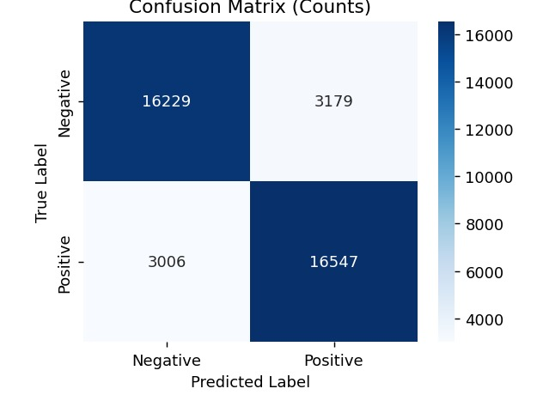
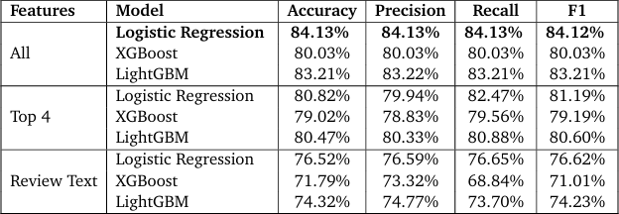
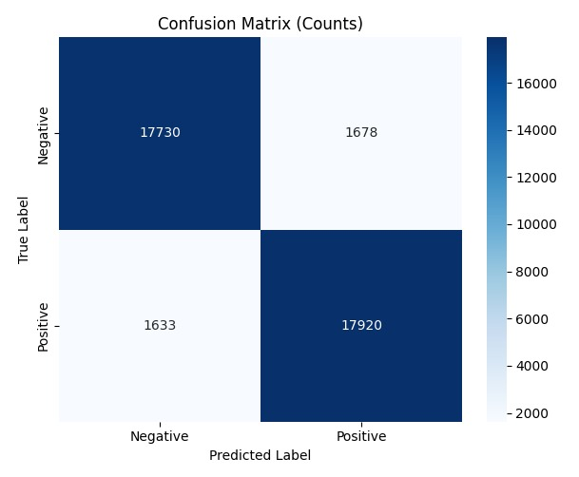
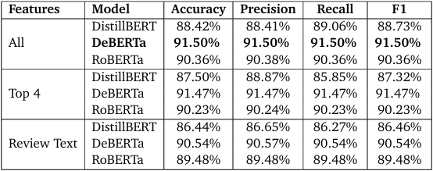
Binary Classification Results
Fig : Performance of ML Models (Binary)
Fig : Logistic Regression all features (Binary)
Fig : Performance of Transformer Models (Binary)
Fig : DeBERTa all feature (Binary)

Slide 34
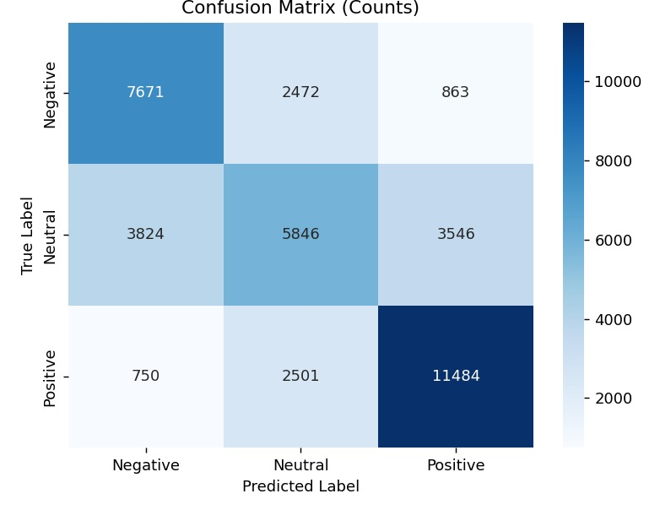
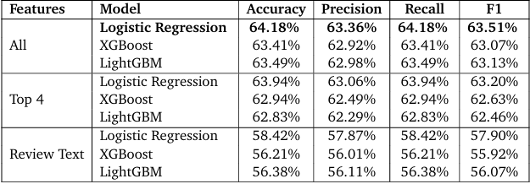
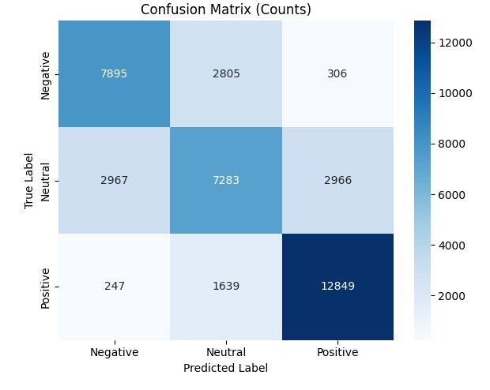
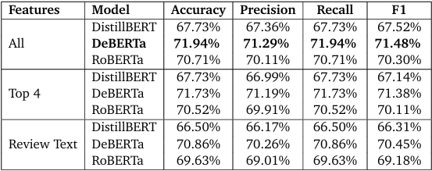
3-class Classification Results
Fig : Performance of ML Models (3 class)
Fig : Logistic Regression all features (3 class)
Fig : Performance of Transformer Models (3 class)
Fig : DeBERTa all features (3 class)

Slide 35
Analysis and Findings
Text Alone is Weak in some cases and metadata helps
Neutral class is hard to detect
DeBERTa is the best performer
Top – 4 feature set performed nearly as good as all feature set

Slide 36
Project Management
Management and Cost Analysis
Project Scheduling

Slide 37
Management and Cost analysis
4 – Phase Lifecycle : Planning, Execution, Monitoring, Control
Direct Expenses : Computation (Google colab), Visualization (canva) and Storage(Google one)
Human Capital and other Expenses

Slide 38
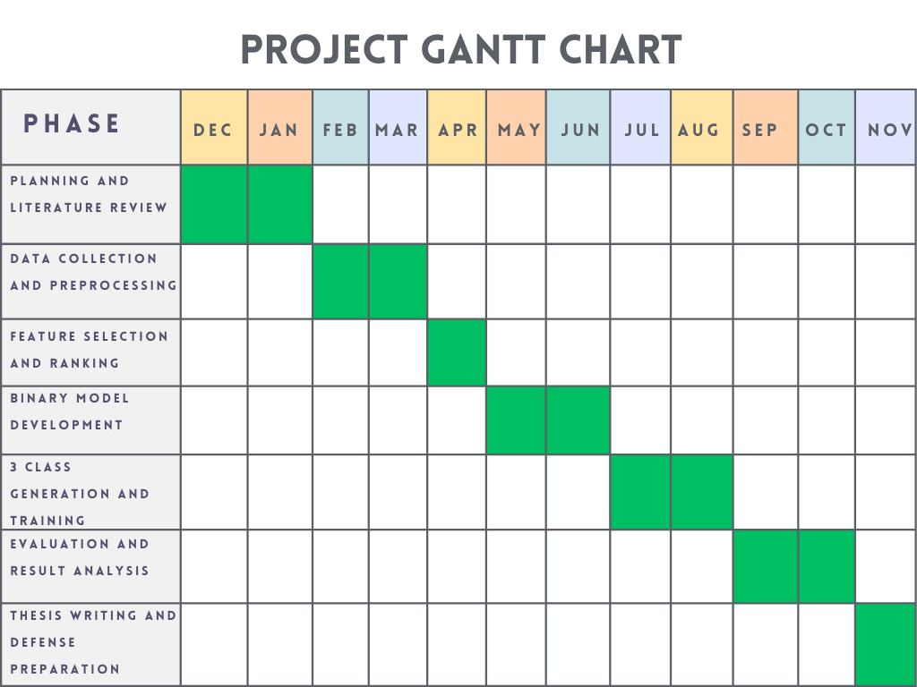
Project Scheduling
Fig : Project Gantt Chart

Slide 39
Ethics AND PROFESSIONAL responsibilities
Responsible Data use
Resisting Oversimplification
Mitigating Bias
Academic Integrity

Slide 40
Complex Engineering problem solving
Depth of Knowledge & Analysis (P1, P3)
Conflicting Requirements and interdependence (P2,P7)
Non-Standard Implementation (P4, P5)

Slide 41
Complex Engineering Activities
Innovation & Resources (A1, A3)
Societal & Environmental Impact (A4)
Level of Interaction and Familiarity (A2,A5)

Slide 42
Future works
Move beyond simple “Late Fusion” and towards a
Hybrid Fusion Architecture
Implementation of Cross attention mechanism where
Metadata directly modulates transformers internal
attention weights.

Slide 43
CONCLUSION
We demonstrated that effective sentiment analysis demands contextual awareness. By integrating strategic metadata, our framework successfully resolved ambiguous 'Neutral' sentiment and outperformed traditional baselines with high efficiency

Slide 44
Reference
[1] U. Dahir and K. Alkindy Faisal, “Utilizing machine learning for sentiment analysis of
imdb movie review data,” In: (2023)
[2] K. Soni, Rahul and P. Yadav, “Comparative analysis of rotten tomatoes movie reviews
using sentiment analysis,” In:(2022)
[3]Ahmad Daniel Azahree, Norma Alias. "Understanding Viewer Opinions: Sentiment Analysis on Movie Reviews Using VADER and LSTM Model." In: (2024)
[4] J. Lu, H.Fan, and Y.Zhang, “Sentiment analysis of imdb movie reviews based on lstm,”
In: (2025)
[5] R.Gao, “Bert+bilstm: Boosting performance in movie review sentiment classification,”
In: (2025)
[6] Sarwar Shah Khan, Yasser Alharbi. "Sentiment analysis of movie review classifications using deep learning approaches." In: (2024)

Slide 45

Thank
You

